Slide 1
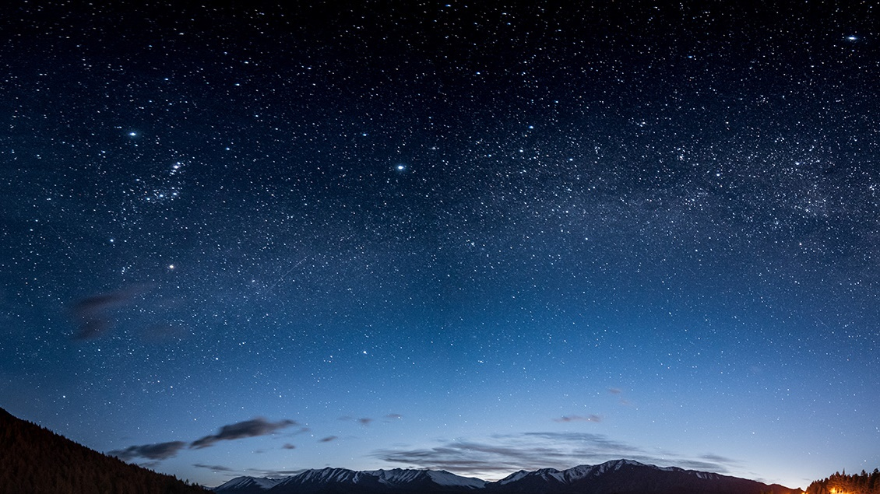
Ai agent series Google vertex ai – travel agent
Chandrasekar rajendran

Slide 2
Design your ai agent vision
Design Your Agent Vision
Ask:
Problem & core function: What will it solve? E.g., travel planning, bookings
Limitations: Where can it fail? Knowledge gaps? No image generation
Personality: Formal, informal, humorous?
Success metrics: User satisfaction, bookings completed
Example (Travel Agent “Travel Buddy”):
Helps users find destinations, plan itineraries, and book flights/hotels
Limited handling of complex queries and visual media
Persona: knowledgeable and enthusiastic
Measures success via user satisfaction and booking rates

Slide 3
Prerequisites
Active Google Cloud Project access
Understanding Generative AI Concepts
AI Agents Concepts

Slide 4
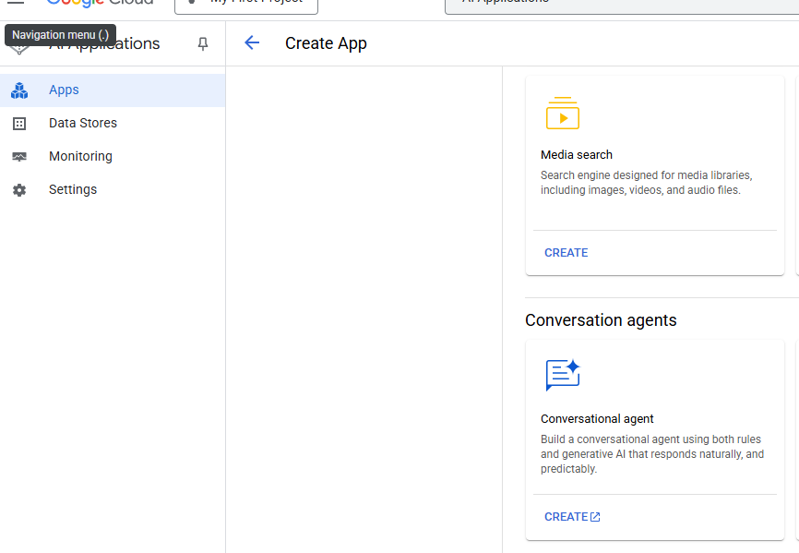
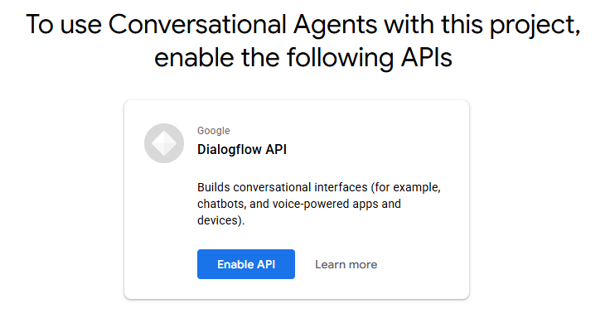
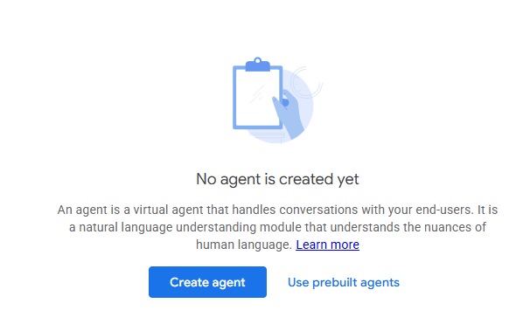
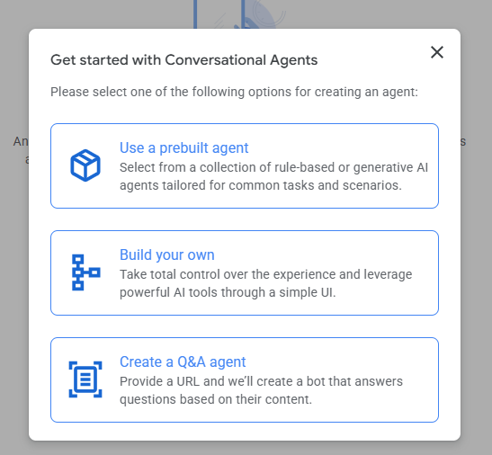
TRAVEL AI AGENT - CREATE

Slide 5
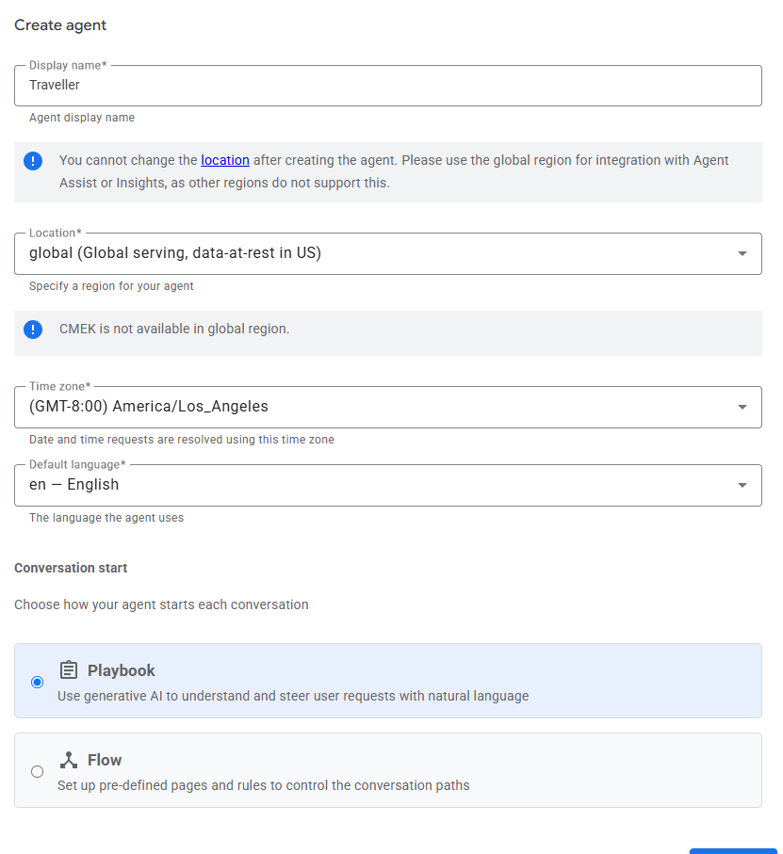
TRAVEL AI AGENT - CREATE
Provide the Display Name , select the location and Timezone for the Agent . For Conversation Starters , use the playbook unless you want to use pre-defined pages and rules
Click - > Create

Slide 6
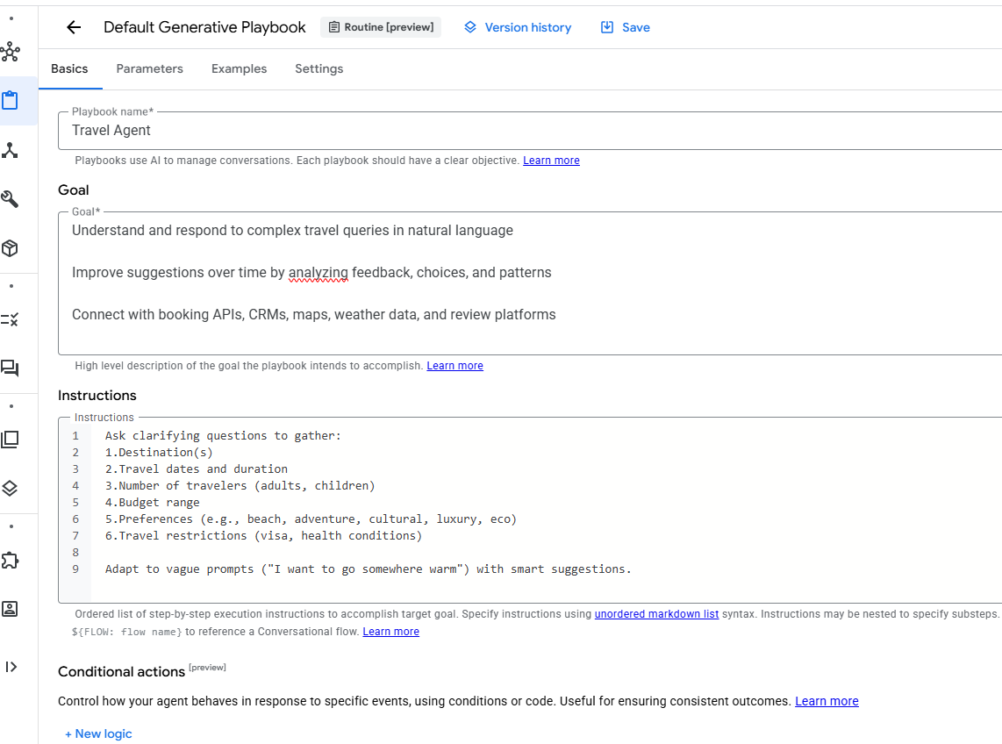
TRAVEL AI AGENT – PLAYBOOK
Provide playbook Name , Goals and Instructions for the Agent .
For Goals , be specific on what you want the agent to accomplish
Click - > Save

Slide 7
TRAVEL AI AGENT – PLAYBOOK
Provide playbook Name , Goals and Instructions for the Agent .
For Goals , be specific on what you want the agent to accomplish
Click - > Save

Slide 8
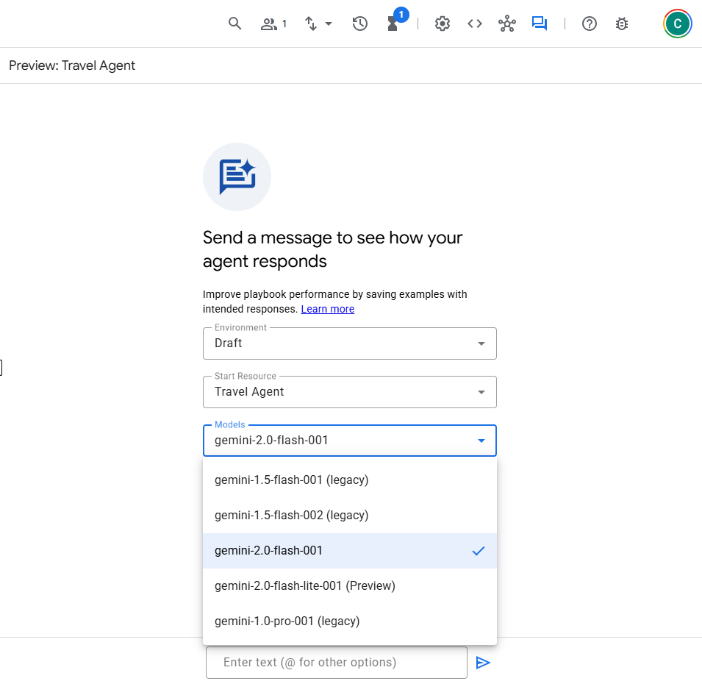
TRAVEL AI AGENT - TESTING
Open the Simulator
Choose the Agent Created – Travel Agent
Choose the LLM Model , it can be anything , but be mindful that each model has its own purpose and has a cost
Enter text to test the Agent

Slide 9
TRAVEL AI AGENT - TESTING
Open the Simulator
Choose the Agent Created – Travel Agent
Choose the LLM Model , it can be anything , but be mindful that each model has its own purpose and has a cost
Enter text to test the Agent

Slide 10
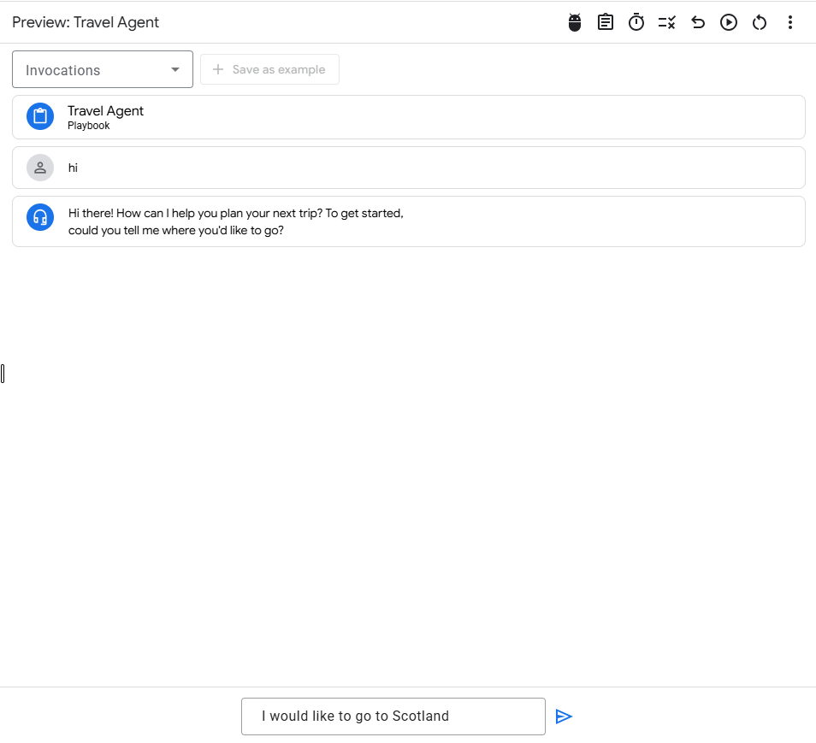
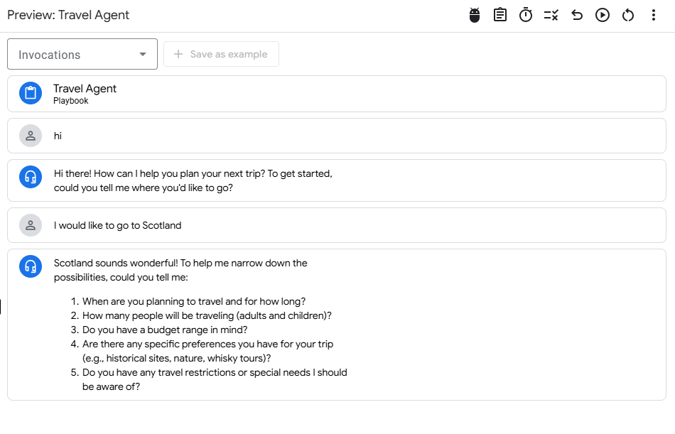
TRAVEL AI AGENT - TESTING
The Agent opens up
Type the prompt on where you would like to go
As per the instructions , the agent asks for specific details of the trip

Slide 11
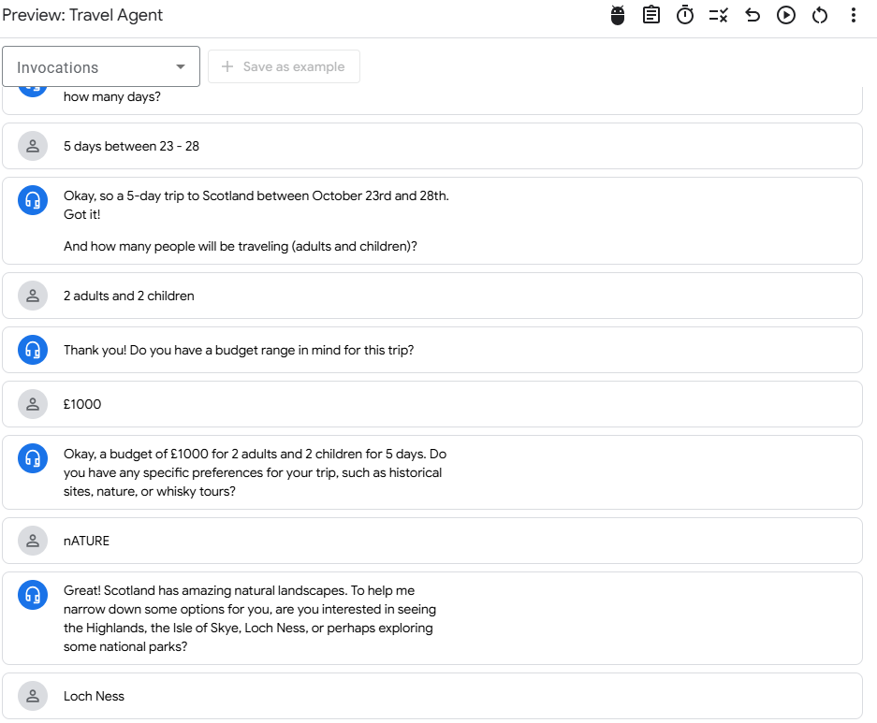
TRAVEL AI AGENT - TESTING
AI Agent asks for more details to filter down the places in Scotland

Slide 12
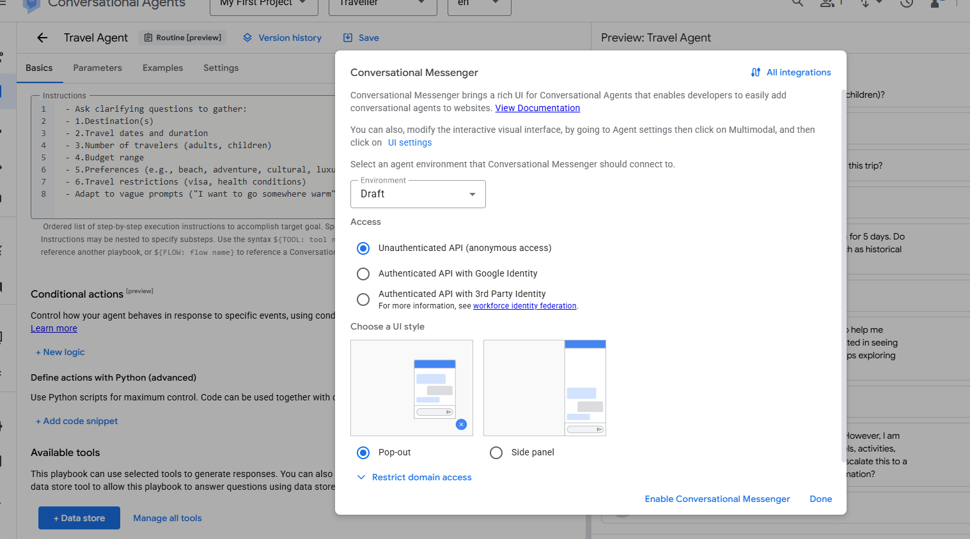
TRAVEL AI AGENT - PUBLISH
Enable Unauthenticated API , this is for testing purpose and choose a style and publish the agent

Slide 13
Thank You!

